Slide 1
Planetary Motion
We’re finally here!

Slide 2
Centripetal Motion

Slide 3
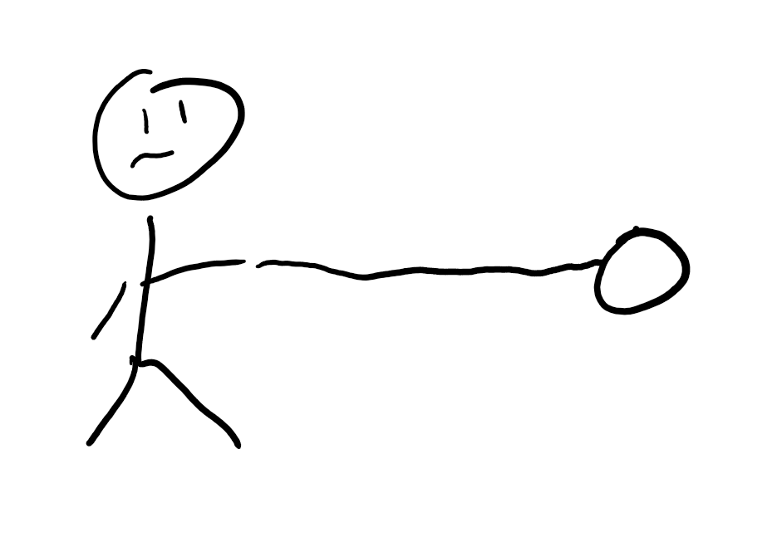
Ball on a rope
When you swing some object tied on a rope, what path does it follow?
What direction is the force on the object?

Slide 4
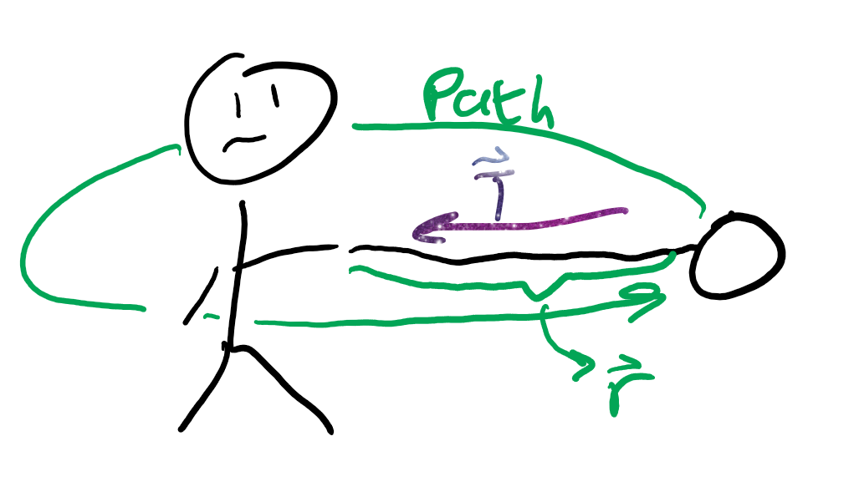
Inward forces
Centri (center) petal (seeking) forces are forces that go toward the center.
These forces cause circular motion.

Slide 5
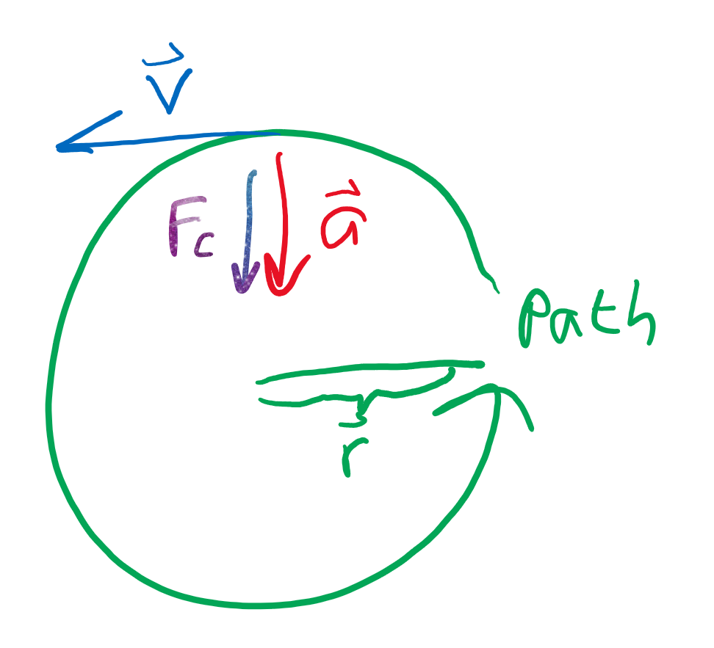
Vectors?
The force (and acceleration) are directed inward
The velocity is “tangent”/“touching” the circular path
The path is, well, I said it already, but it’s circular

Slide 6
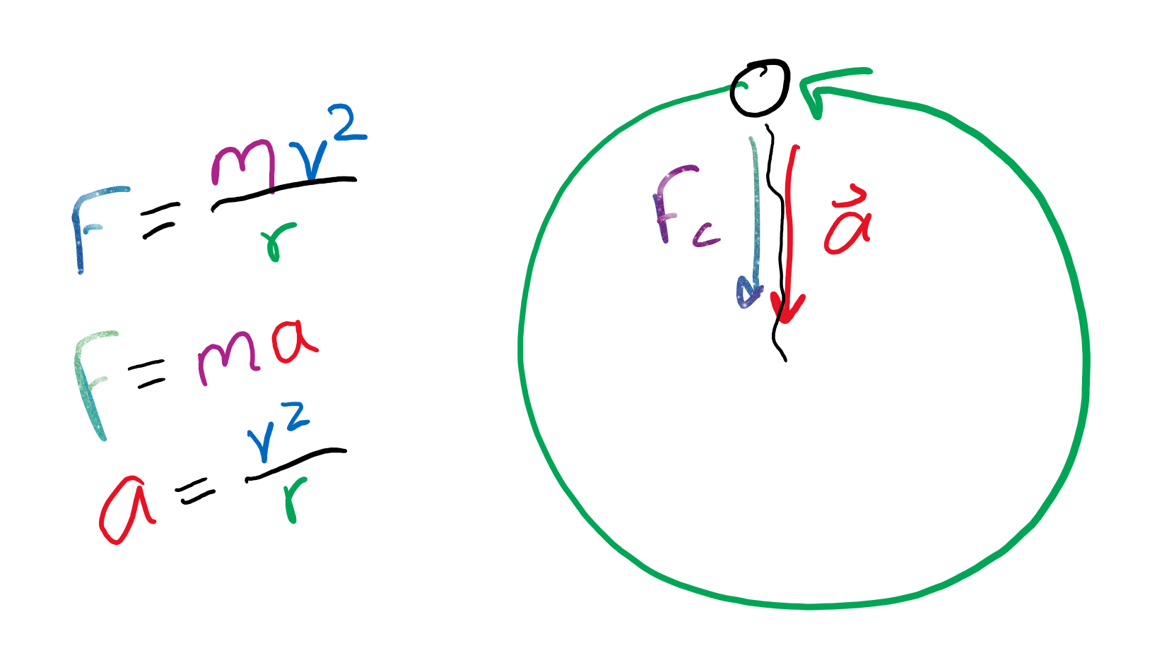
Equation (uh oh spaget)
F_c = m v^2 / r
F = m a, so a = v^2 / r

Slide 7
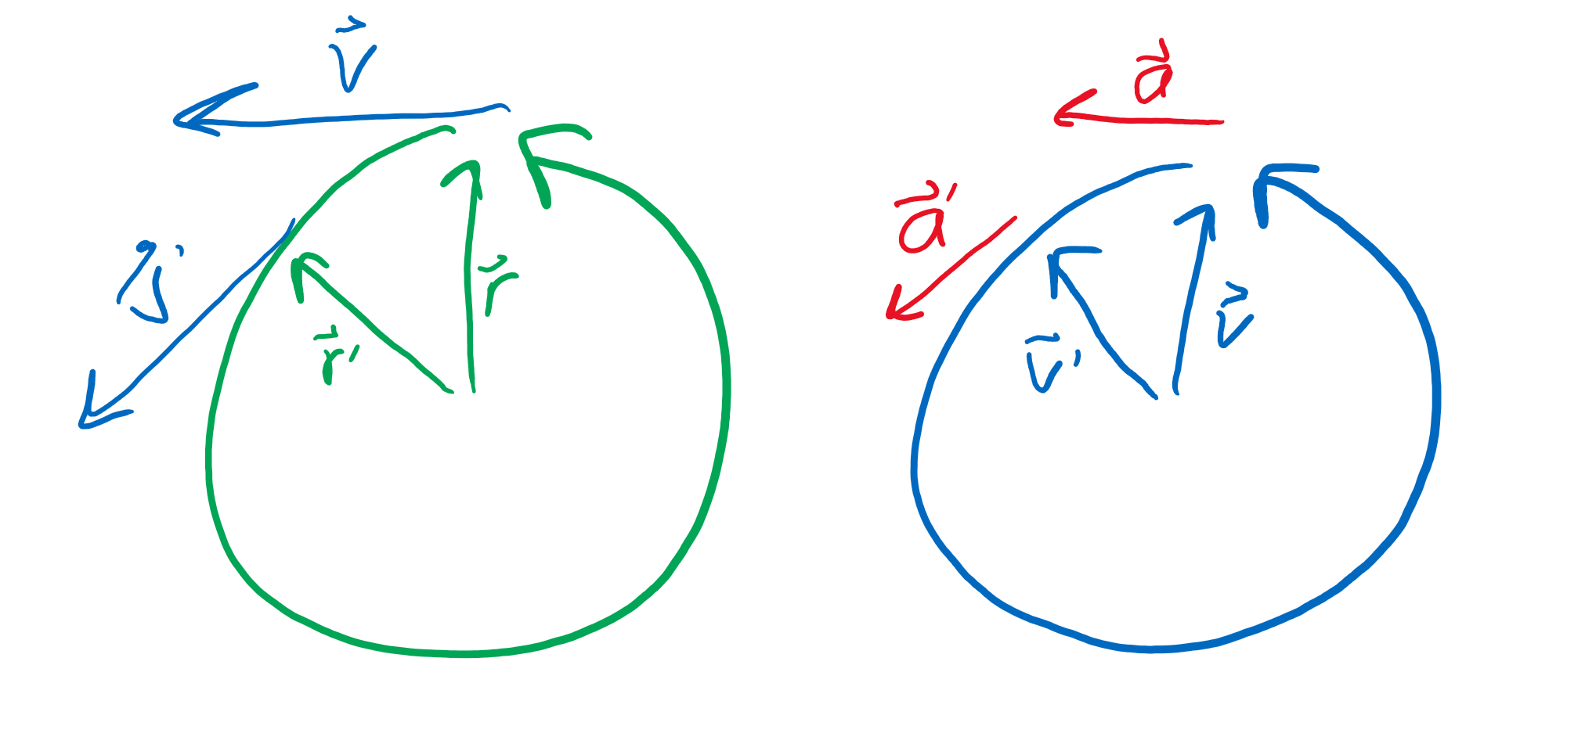
Proof?
Velocity is change in distance over time (v = d / t).
If a constant F_c is applied, velocity doesn’t change.
The time it takes to move an entire circle (on left) is therefore d / v.
Distance traveled around the circle is 2 (pi) r, so t = 2 (pi) r / v.

Slide 8
Proof (2 electric boogaloo)?
Velocity also “moves in a circle.”
Acceleration is change in velocity over time (a = s / t), so the time it takes to travel the full “velocity circle” is s / a.
The total “velocity” over the circle is 2 (pi) v, so t = 2 (pi) v / a.
The two “t”s from the two slides are equal, so 2 (pi) r / v = 2 (pi) v / a, so we get a = v^2 / r.

Slide 9
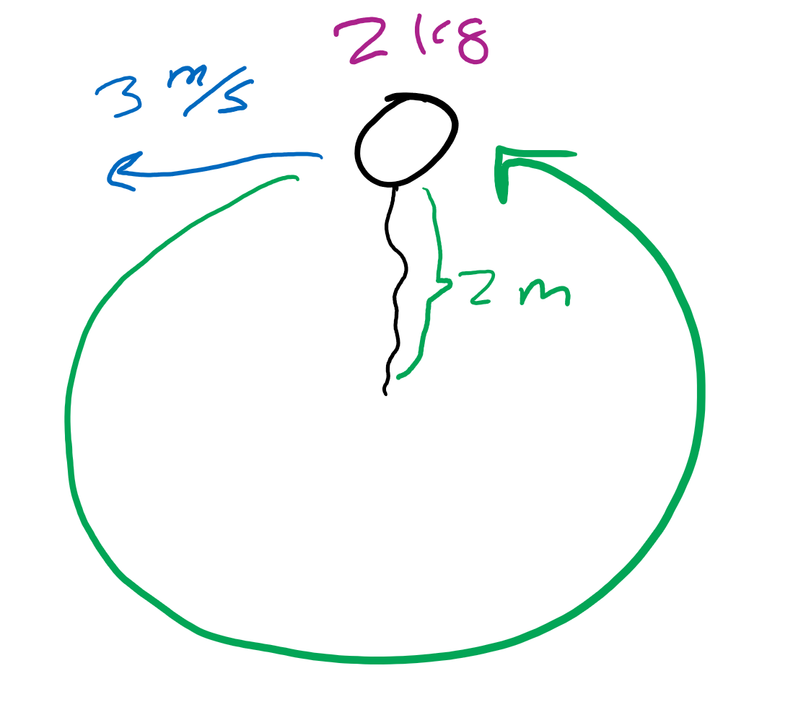
Review
What force do I need to keep a mass of 2 kg traveling at a speed of 3 m/s in a 2 m orbit.
What is the direction of the force?

Slide 10
Gravitation

Slide 11
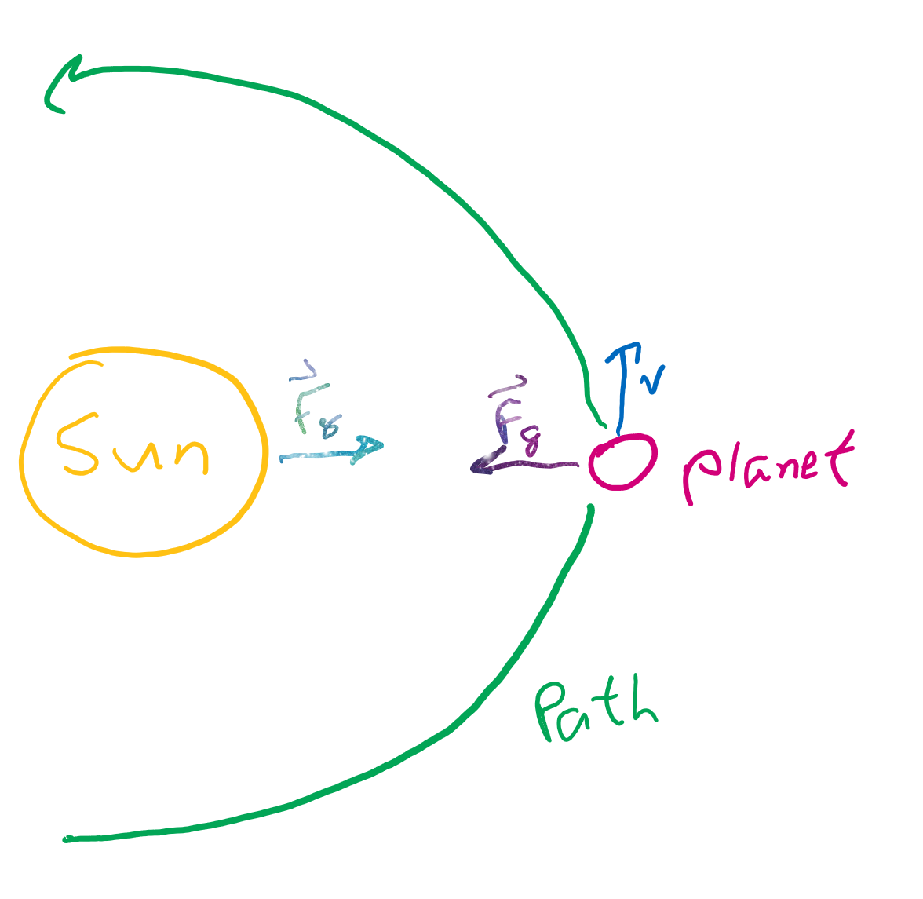
Forces in space
What forces act on planets?
Why are their orbits “circular-ish?”

Slide 12
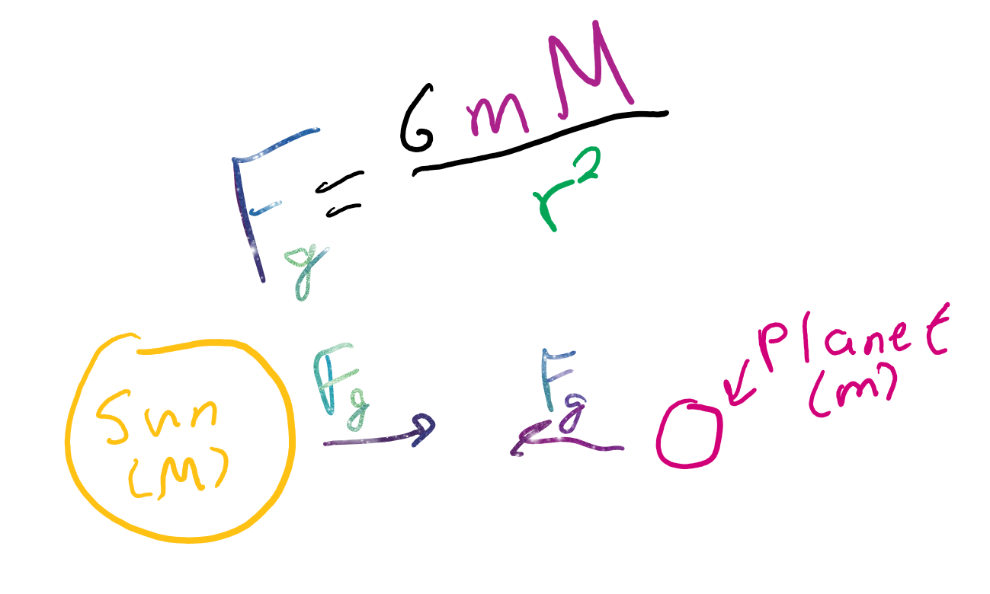
Newton’s Universal Law of Grabibitation
G (gravitational constant): 6.67 * 10^-11 N m^2 / (kg)^2
m (mass of planet)
M (mass of sun)
r (distance between them)
Why is there only one equation for force for both bodies?

Slide 13
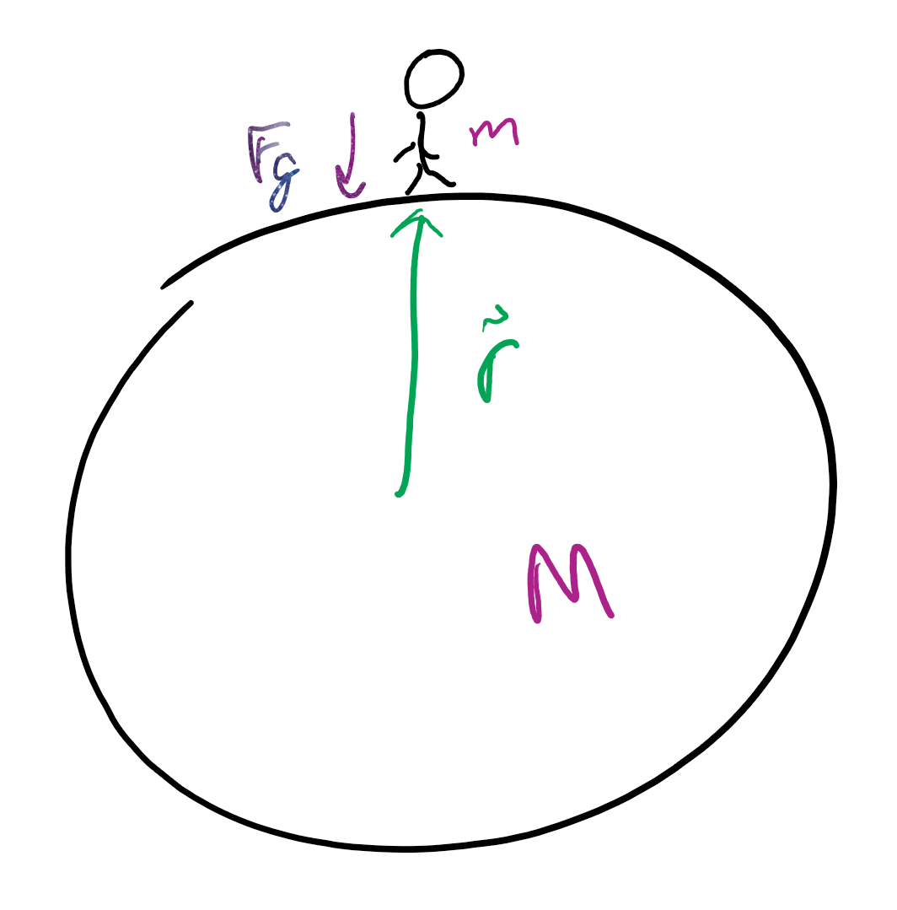
Works for any two bodies
We know our weight is m*g, but how do we find g?
F_g = G m M / r^2, and also that F_g = m a.
That means a = G M / r^2.

Slide 14
How planets really move

Slide 15
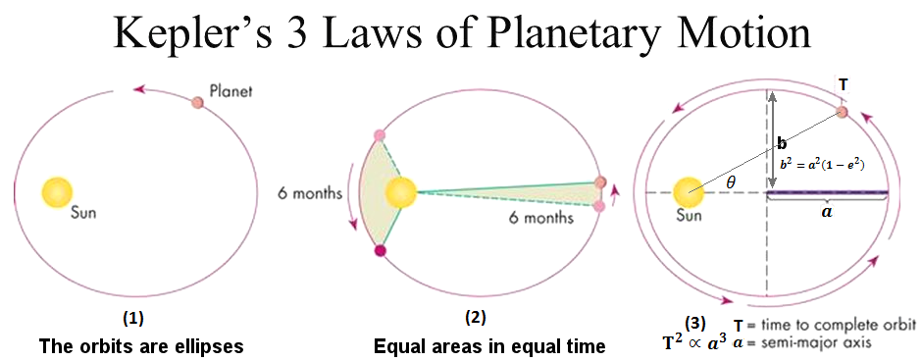
Kepler's 3 Laws
Chimken MacNugett shoot this isn’t google how do I delete this

Slide 16
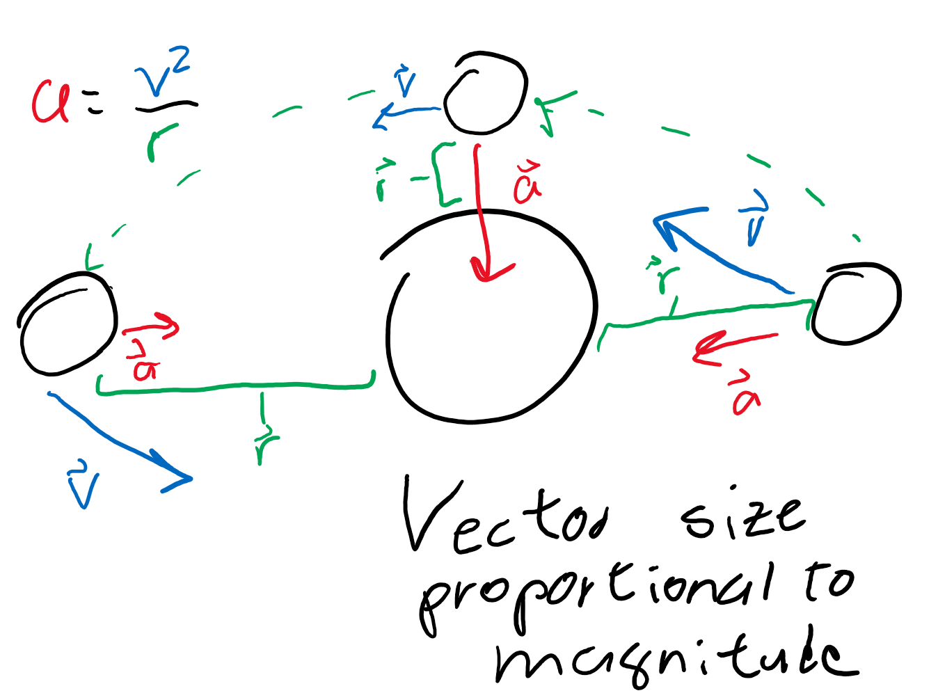
Elliptical orbits?
Think of it like a spring.
If the planet approaches the other planet in a line, the planet will oscillate getting closer and further.
Unless the planet goes into orbit at the perpendicular, orbits will always be elliptical.

Slide 17
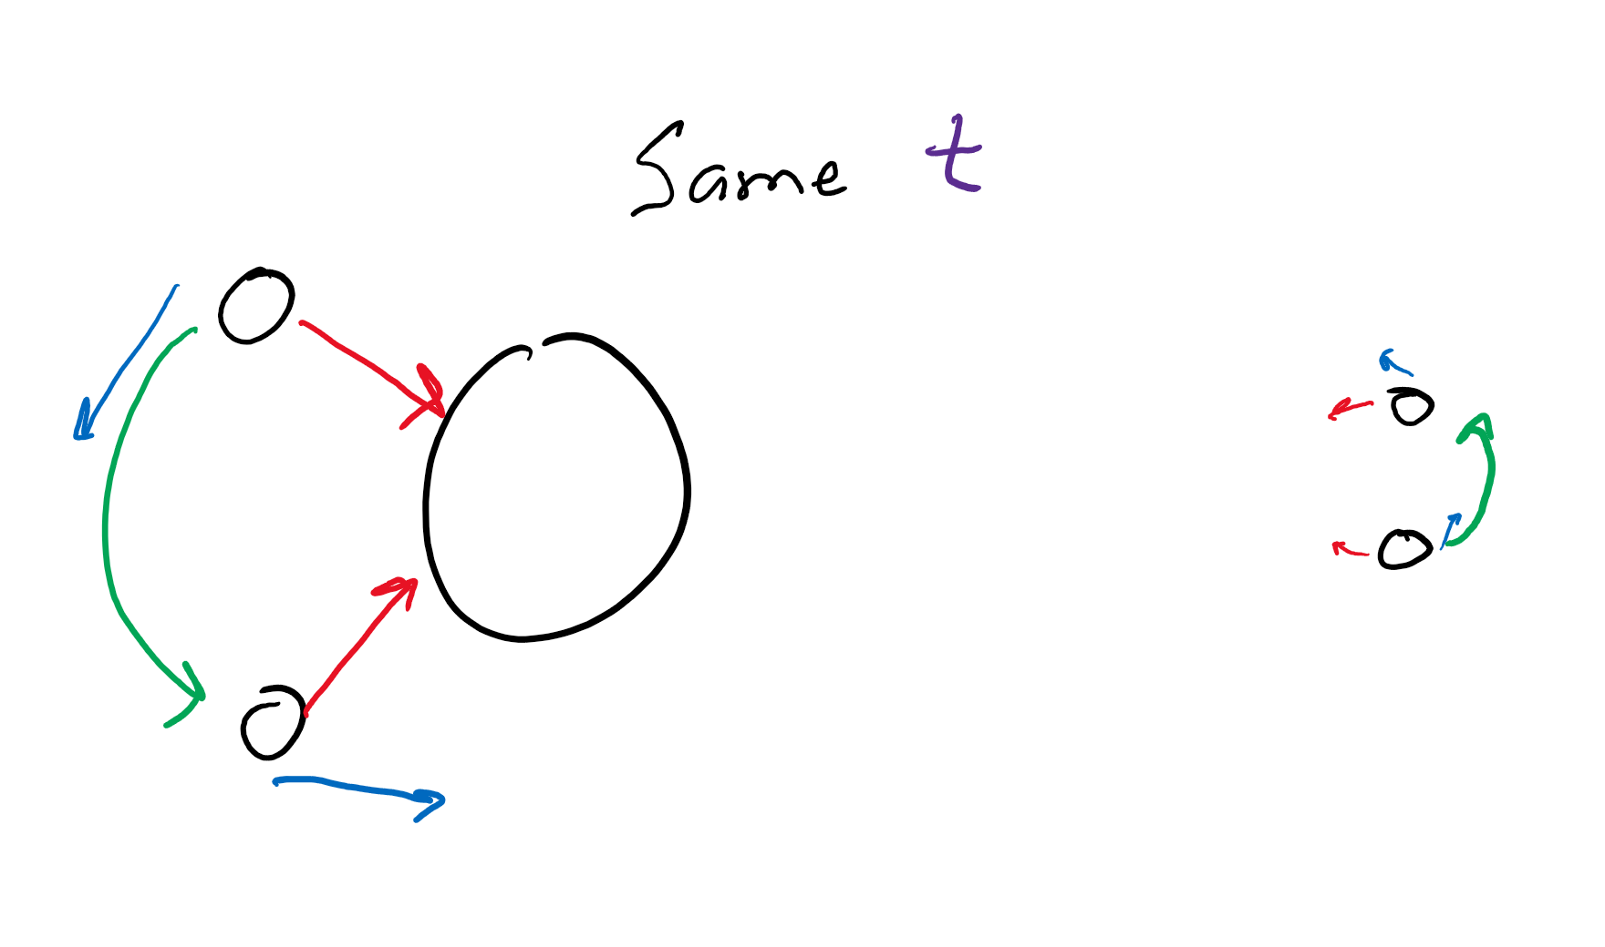
Closer means speedy-er
What happens to the force of gravity when the objects are closer?
How does this affect speed?

Slide 18
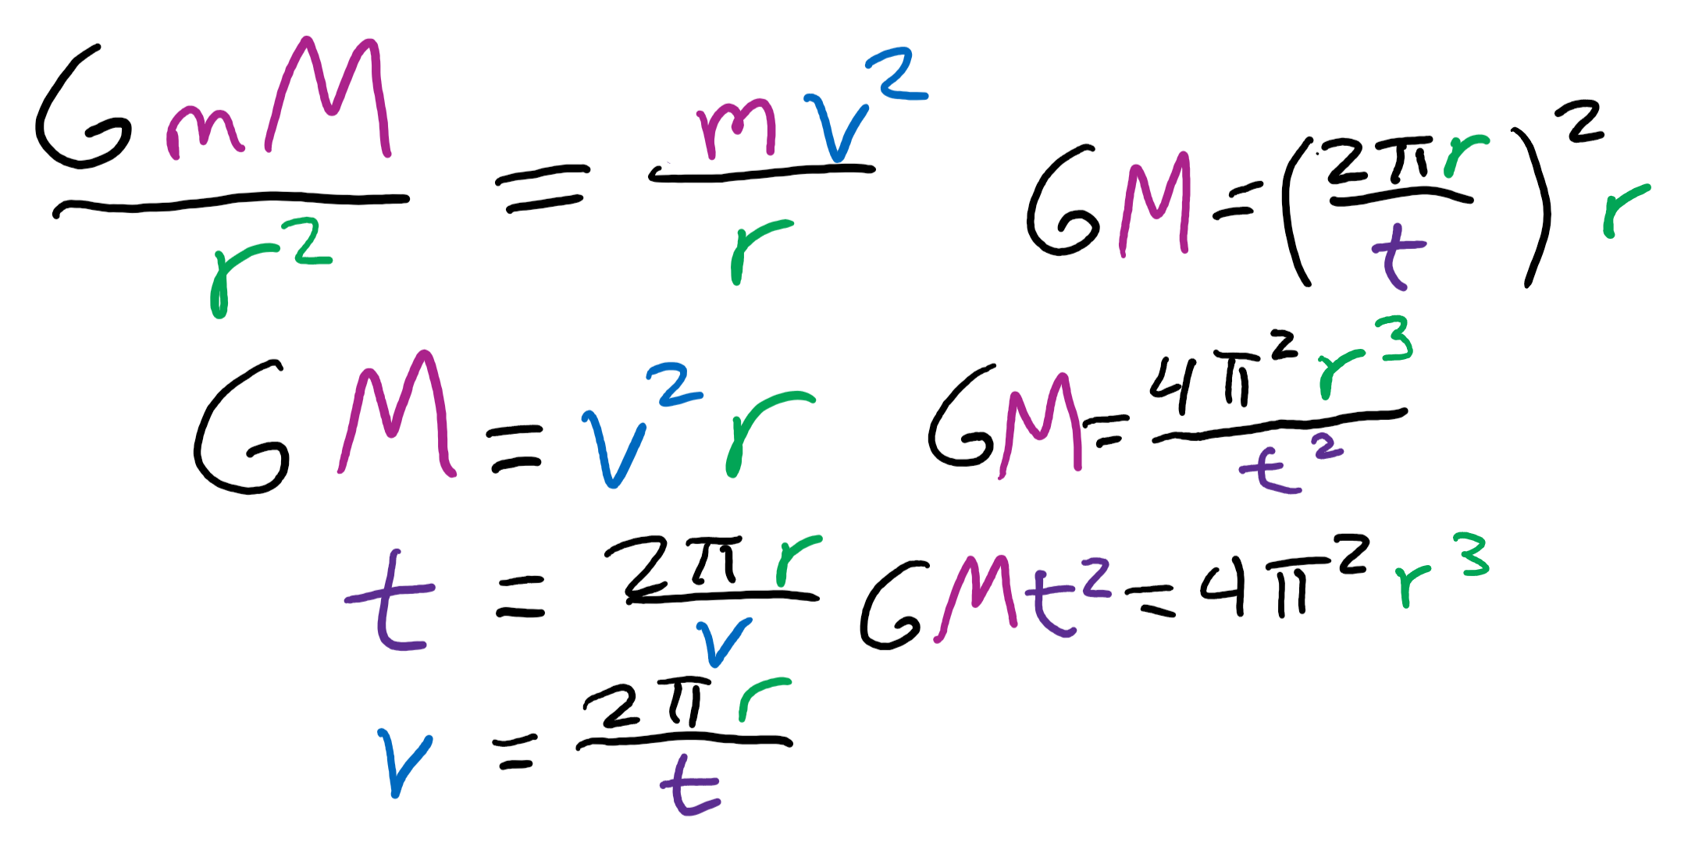
Longer radius, longer time
The further away you are, the longer it takes to orbit.
How is the force affected the further we are?
How does that affect velocity?
And how does that affect distance traveled?

Slide 19
Review?
“Prove” Kepler’s first law
Second law?
Third law?
What is Newton’s Law of Universal Gravitation?
How does it help us find the gravitational acceleration?

Slide 20
“Fictitious” forces

Slide 21
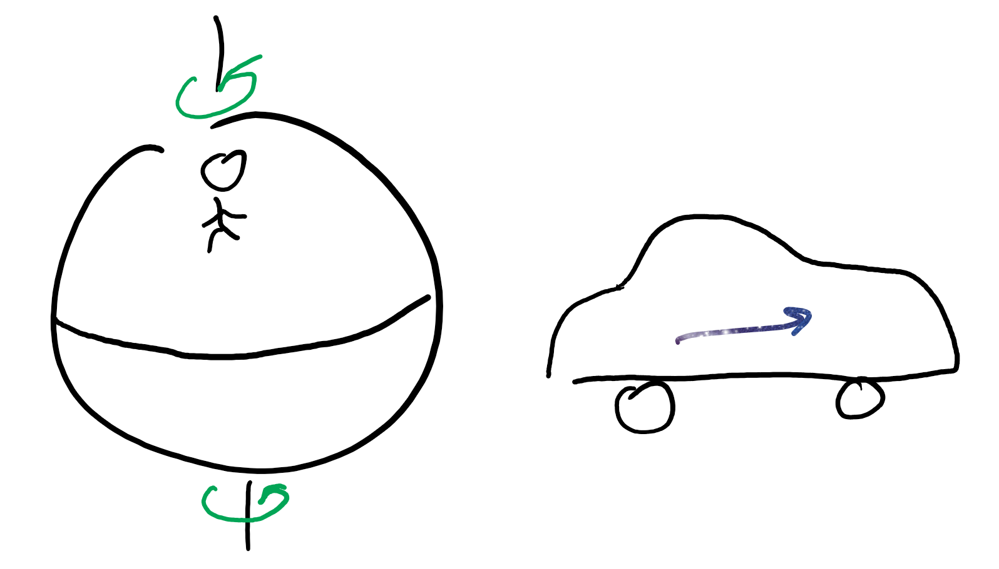
Experienced on an “non-inertial” frame
You are moving.
Aka, you have “inertia.”

Slide 22
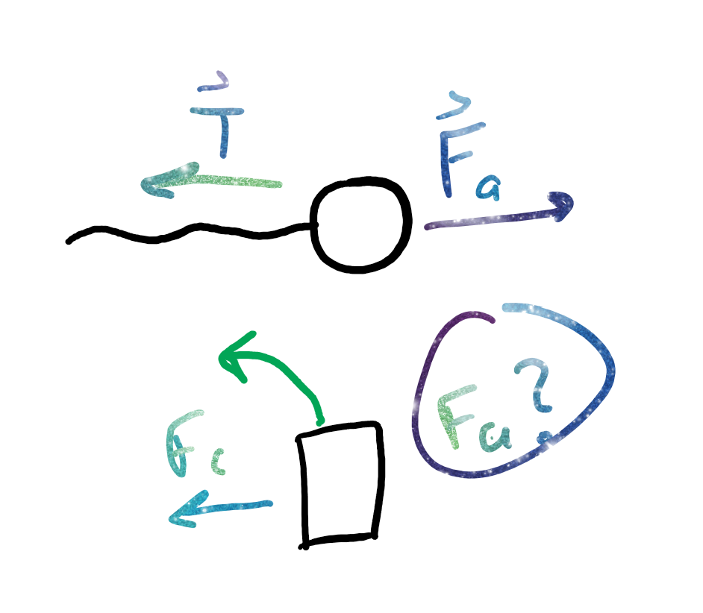
Centrifugal force
A result of inertia.
Proportional to F_c.
When you take a left turn on a car, what direction do you feel like you’re being pulled in?
Does it feel like a force?

Slide 23
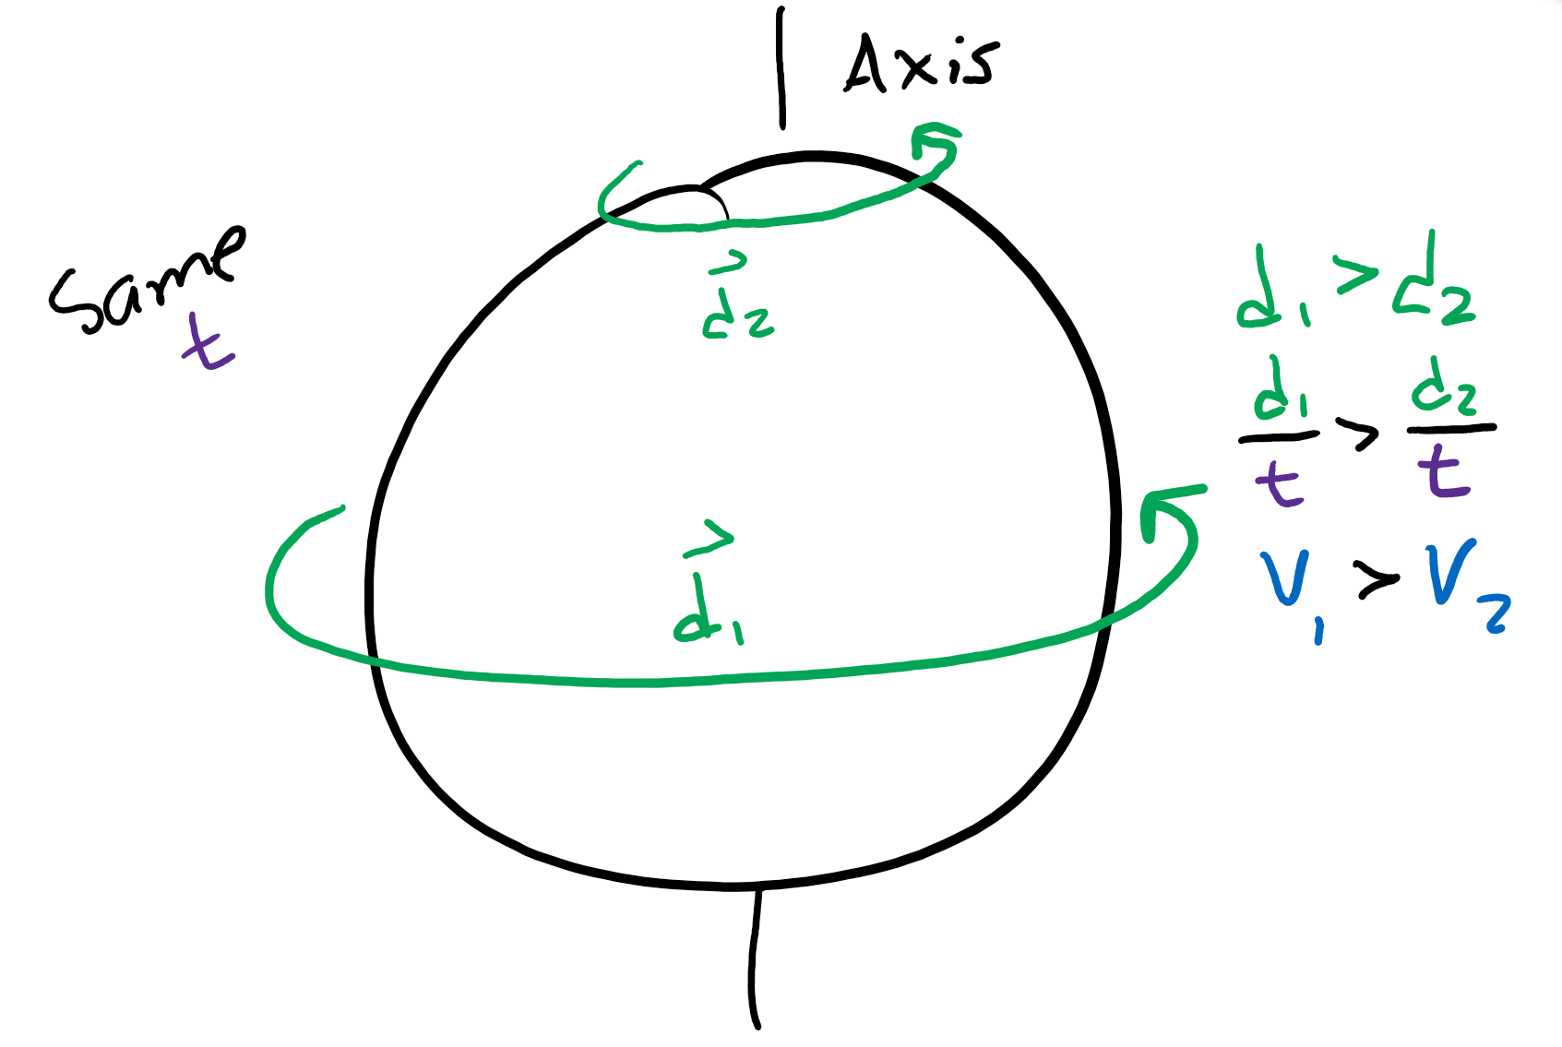
Why do planets bulge pt 1?
The equator spins a lot further than places by the poles.
That means the velocity around the equator is much bigger.

Slide 24
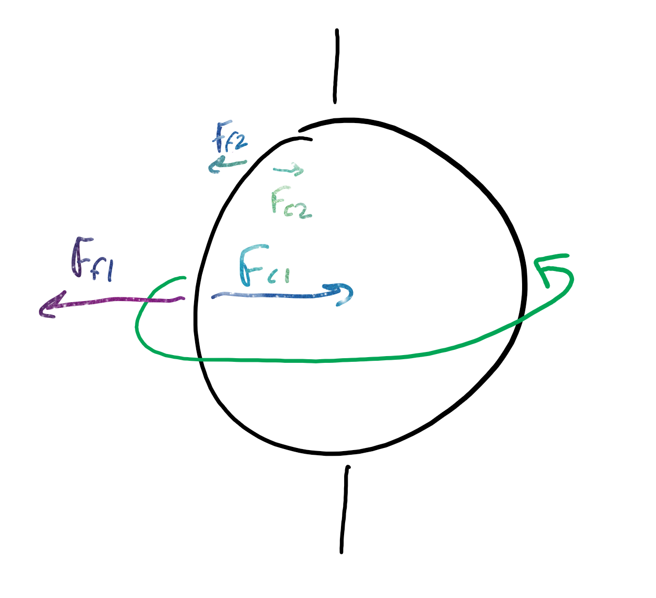
Why do planets bulge pt 2?
The centripetal force is proportional to velocity, so the centripetal force along the equator is much bigger.
The centrifugal force is an “equal and opposite” force to the centripetal force, so the equator is pushed out a lot more than the poles.

Slide 25
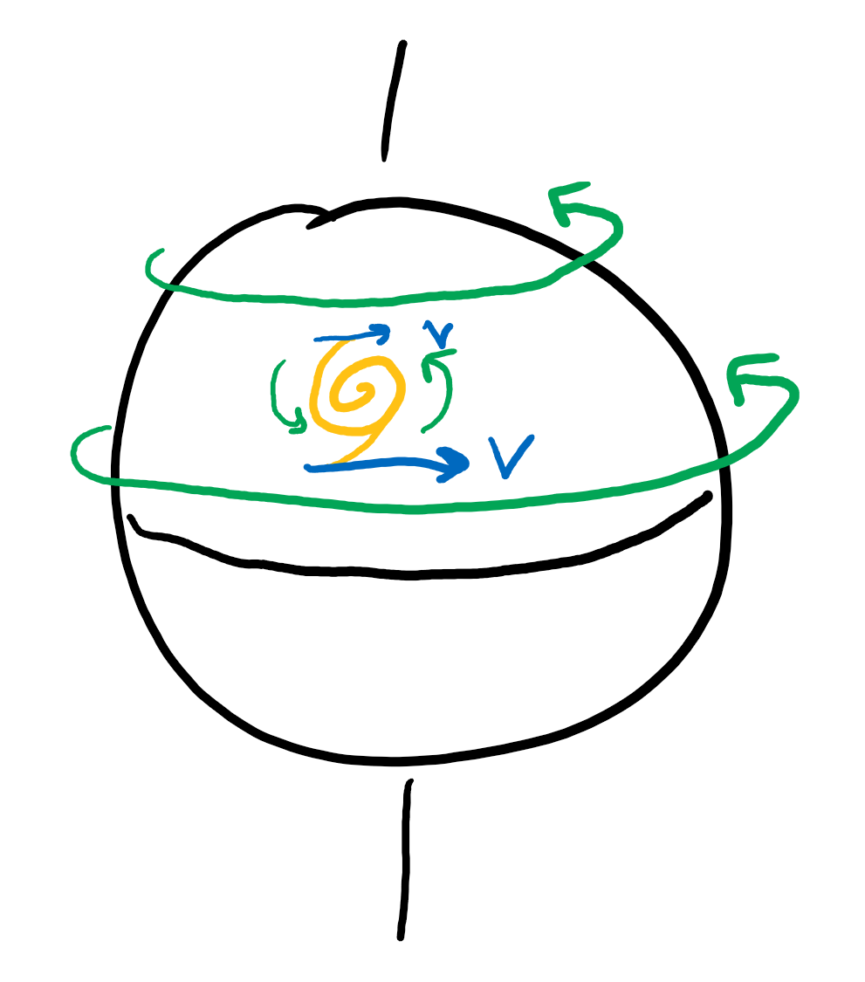
Coriolis force
On the Earth, the velocity by the equator is larger than the velocity away from the equator.
This makes the hurricanes “spin.”

Slide 26
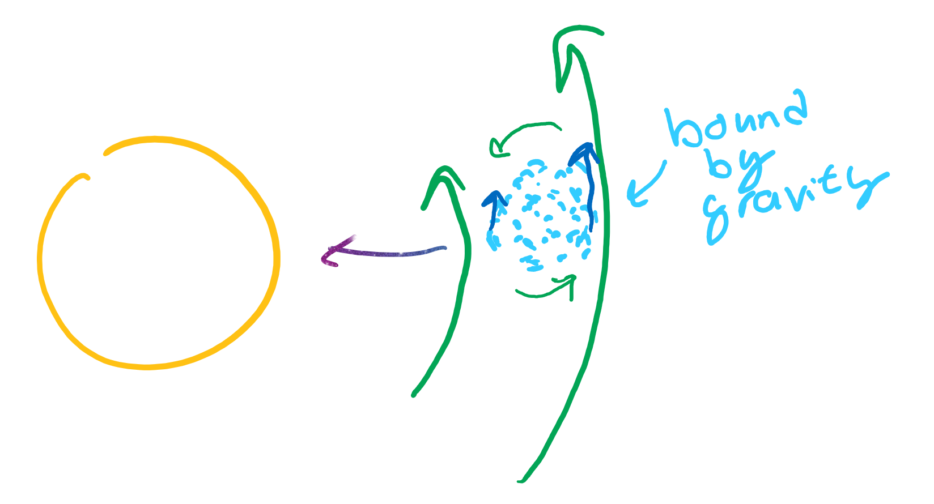
Why planets spin a certain way
Very similar to the reason hurricanes rotate.
When planets were particles, those further away have a larger velocity; thus, spin.
Why does this effect not cause Venus to spin the “right” way?

Slide 27
Fictitious forces?
When have you experienced the “centrifugal” force?
Coriolis force?
How do these forces factor into how our planets move?

